Slide 1

Guidance for DCJS Grantees
Prompt Contract Execution
Timely Voucher Payment
Grantee/Contract Auditing
Fall 2019

Slide 2

Goal of this Webinar:
Assist Grantees by providing information and instruction that will facilitate timely contract execution and voucher processing.
Provide an overall understanding of contracting with and receiving payments from DCJS.

Slide 3
Today’s Agenda:
Developing and Executing Local Assistance Contracts
Completing and Submitting Fiscal Paperwork for Processing and Payments
Grantee Audits

Slide 4
Introductions:
Jodi Clark – DCJS Office of Program Development and Funding (OPDF)
Public Safety Grants Representative 2
Holly Stefaniak – DCJS Finance
Supervising Budget Analyst
Chris Amado – DCJS Finance
Chief Budgeting Analyst
John Clements– DCJS Office of Audit Services
Deputy Director

Slide 5
Grantees connect with many Offices within DCJS:
Program
OPDF
OJRP
Finance
Audit
Examples of other Offices that work in conjunction with OPDF to develop and manage programs
Office of Program Development and Funding
Office of Justice Research and Performance
Finance Office
Office of Audit Services and Compliance
Contract Development and compliance
Budgets
Contract Monitoring/ Technical Assistance
Quarterly Case Specific data submission
Feedback reports
Fidelity Assessments
Recidivism studies
Process Claims for payments
Review Supporting Documentation
Reimbursement
Conduct audits to ensure compliance with requirements of funding and contract
OPCA – Office of Probation and Correctional Alternatives
OPS – Office of Public Safety
OVS – Office of Victim Services

Slide 6
This Webinar will introduce 3 offices within DCJS that work with Grantees:
Program
OPDF
OJRP
Finance
Audit
Examples of other Offices that work in conjunction with OPDF to develop and manage programs
Office of Program Development and Funding
Office of Justice Research and Performance
Finance Office
Office of Audit Services and Compliance
Contract Development and compliance
Budgets
Contract Monitoring/ Technical Assistance
Quarterly Case Specific data submission
Feedback reports
Fidelity Assessments
Recidivism studies
Process Claims for payments
Review Supporting Documentation
Reimbursement
Conduct audits to ensure compliance with requirements of funding and contract
OPCA – Office of Probation and Correctional Alternatives
OPS – Office of Public Safety
OVS – Office of Victim Services

Slide 7
NYS Division of Criminal Justice:
Mission Statement
The New York State Division of Criminal Justice Services (DCJS) has a mission to enhance public safety by providing resources and services that inform decision making and improve the quality of the criminal justice system.

Slide 8
DCJS Office of Program Development and Funding (OPDF):
Administration of more than 30 local grant programs with annual funding of approximately $200 million.

Slide 9
DCJS OPDF:
  Administering State and Federal grant programs aimed at crime prevention and control.
  Coordinating the effective and efficient distribution of State and Federal funds.
  Providing technical assistance and training to grant recipients.
    Monitoring grantee performance and compliance with contract terms and ensuring the integrity of grant recipients.
  Developing and executing contractual agreements with grant recipients.

Slide 10
OPDF Organization:
  40 employees
  80% Public Safety Grant Representatives
  Office organized into five grant units, each administering contracts funded by various funding streams to support grant programs in given policy areas:
      Law Enforcement & Legal Services Unit
      Community Corrections & Re-entry Unit
      VAWA/Victim Services Unit
      State, Labs & Federal Programs Unit
      Administration Unit

Slide 11
Key Grant Programs administered by OPDF:
  Gun Involved Violence Elimination (GIVE) Initiative
  Aid to Prosecution; New York Prosecutors Training Institute (NYPTI)
  Aid to Defense; Indigent Legal Services
  Motor Vehicle Theft & Insurance Fraud Prevention
  Crimes Against Revenue Program (CARP)
  13A Alternatives to Incarceration Programs
  Recidivism and Incarceration Reduction Programs
  Community Re-entry Task Forces
  Jail-Based CBI Programs
  Employment Services Programs
  Services, Training, Officers, Prosecution (STOP) Violence Against Women Act (VAWA)
  Sexual Assault Services Program (SASP)
  Sexual Assault Crisis and Prevention Programs
  Byrne/JAG
  Juvenile Justice Title II
  Operation SNUG
  Aid to Crime Labs & Coverdell
  Legislative Grants

Slide 12
OPDF currently works with grantees to develop contracts using two contract management systems:
  DCJS Grants Management (GMS) System - OPDF manages the GMS; including registration of grantees, resetting log-in info and general maintenance of grantee accounts.
  DCJSFUNDING@dcjs.ny.gov or (518) 457-9787
  NYS Grants Gateway - OPDF assists grantees with the transition to the statewide NYS Grants Gateway system; all grantees should begin registering in the Gateway, including municipalities. grantsgateway@its.ny.gov or (518) 474-5595
      https://grantsmanagement.ny.gov/register-your-organization
      https://grantsmanagement.ny.gov/videos-grant-applicants
      https://grantsmanagement.ny.gov/live-webinars
Eventually all contracts will be managed in the NYS Grants Gateway – Information will be provided to grantees during the award notification process.

Slide 13
Award to Contract Execution
Once grantees receive an award, OPDF works with grantees to develop contracts.
Contracts must be executed before any payments to grantees can be made.
OPDF works with grantees to get contracts executed on time – preferably prior to contract start date
Award Notice Sent by DCJS OPDF
Contract Development with Grantees and OPDF
Contracts Executed and Contract Monitoring Begins
Program Reporting and Fiscal Voucher – occurs after Contact is Executed

Slide 14
How can OPDF assist grantees with Contract Execution?
  Pre-Award
  Not-For-Profit Grantees:
      Be mindful of your Grants Gateway Prequalification.
      Ensure your Vendor Responsibility is dated within the last 6 months.
  All Grantees: Provide all requested information as soon as possible and within timeframe given.
  Non-Competitive recurring awards, e.g. Legislative initiatives, can have documents such as MOUs, MWBE forms, consultant agreements etc. ready for upload to grants management system with current dates.

Slide 15
How OPDF assists grantees develop and execute contracts?
  Pre-Award
  Competitive awards, RFP/RFA, can have all of the above documents in a draft form ready for completion once they have received final notice of award amount.
  Be prepared with a work plan. If you do not have a recurring grant or a work plan was not established in the award solicitation, your OPDF Public Safety Grants Representative will review program and work scope with you to create a work plan during the contract process.

Slide 16
How OPDF assists grantees develop and execute contracts?
  Post Award and during the contract development process:
  Once you receive your award notice PLEASE read the entire notice including any attachments. Documents have been prepared to help make the process as straightforward as possible.
  OPDF Public Safety Representatives can work with you to develop workplans and will assist with the development of budgets.

Slide 17
How OPDF assists grantees develop and execute contracts?
  Post Award and during the contract development process:
      For municipalities who need legislative approval on contracts - please put this subject on the docket as soon as possible.
      Please provide all requested information as soon as possible and within timeframes given.

Slide 18
How OPDF can assist you?
  Post Contract Execution
    Keep all contacts up to date in both systems: GMS and the Grants Gateway. Note: Please have all individuals add DCJSFUNDING@dcjs.ny.gov to there trusted contacts to avoid e-mails going to their SPAM folder.
    Please be timely with your required reports submissions.
    Be proactive with your grants. If you have any questions about contract development and/or your grants program, please call your designated OPDF Public Safety Grants Representative.
    If you have any financial questions please contact the DCJS Finance Office at DCJSGrantsUnitVoucheringInquiry@dcjs.ny.gov.

Slide 19
  QUESTIONS ?

Slide 20
Submitting Voucher to DCJS Finance For Payment:
Holly Stefaniak – DCJS Finance
Supervising Budgeting Analyst
Chris Amado – DCJS Finance
Chief Budgeting Analyst

Slide 21
What makes up a voucher?
The majority of DCJS contracts are expenditure/reimbursement based; therefore, grantees may only voucher for costs already incurred. Performance based contracts do not follow the same rules and will be covered briefly later in the presentation.
A voucher submitted to DCJS is made up of 3 types of forms:
    Claim for Payment
    Fiscal Cost Report (FCR)
    Detailed Itemization Form (DIF) *Multiple DIFs may be required*
    Note: Duplicates of forms are not needed
The voucher forms can be found on the DCJS website at https://www.criminaljustice.ny.gov/ofpa/applcntgrntfrms.html
Do not alter the forms in any way (i.e. changing/removing headings of columns, etc.).
No other supporting documentation (timesheets, travel receipts, etc.) should be submitted with the voucher.

Slide 22
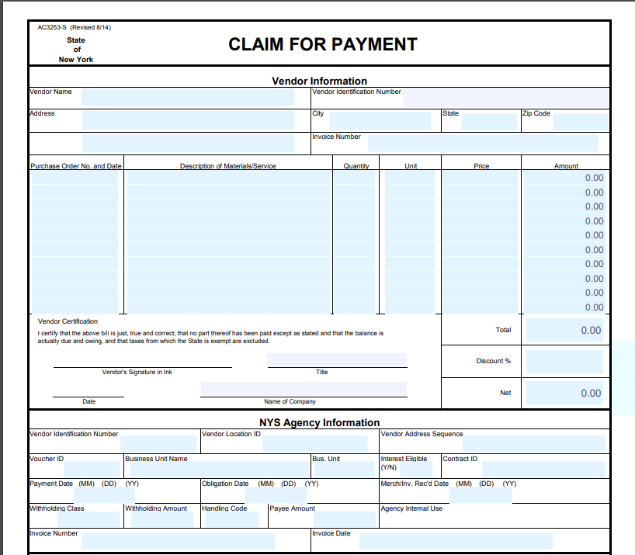
Claim for Payment:
The Vendor ID is your SFS Vendor ID.
Grantee Information.
The Invoice number is the contract number and the report period (i.e. C123456 4-6/19).
Enter the contract number here.
List the report period being claimed and DCJS number here.
The total amount on this form must agree with the totals on the accompanying Fiscal Cost Report (FCR).
An Original Signature is required on the form.
Do not fill out the form below the signature.

Slide 23
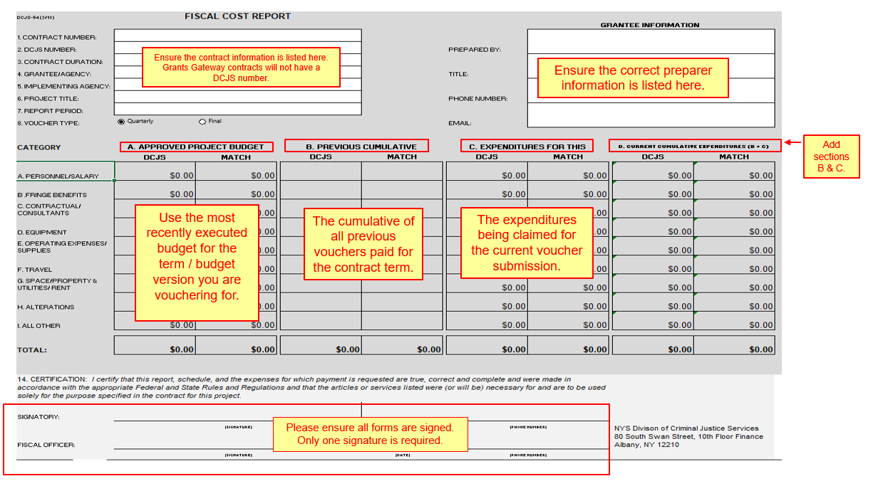
Fiscal Cost Report (FCR) For Expenditure Based Contracts:

Slide 24
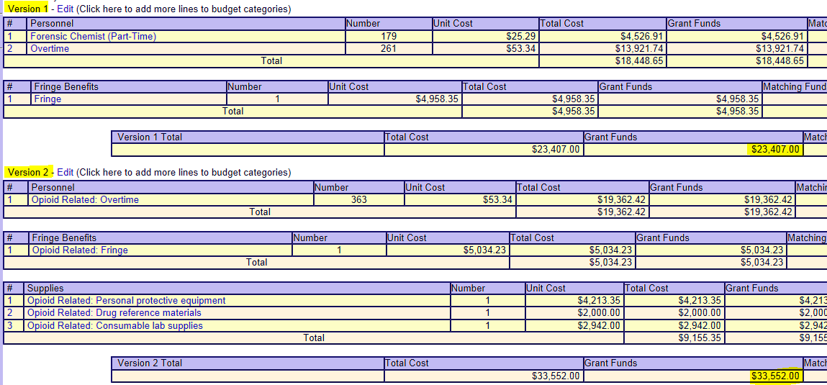
Multiple Version Expenditure Based Budget:
Each budget version needs to be vouchered for separately and have its own voucher submissions(s); corresponding to its distinct DCJS # (separate claim for payment, FCR and DIFs).

Slide 25
Detailed Itemization Form (DIF) :
(Expenditure Based Budget)
There are unique DIFS for each budgetary category that you are vouchering for:
Please make sure it is clear which line on your contract’s budget each itemized expense is for:
  If an Equipment budget contains a line for “Consumable Supplies for HPLC-QTOF Instrument:”
    Not Recommended – “Deactivated Liners”
    Preferred – “Deactivated Liners for HPLC-QTOF Instrument”
    *Any expense that does not clearly roll up to your budget will be questioned or disallowed*
  Personnel/Salary
  Fringe
  Contractual/Consultants
  Equipment
  Operating Expenses/Supplies
  Travel
  Space/Property & Utilities/Rent
  Alterations
  All Other

Slide 26
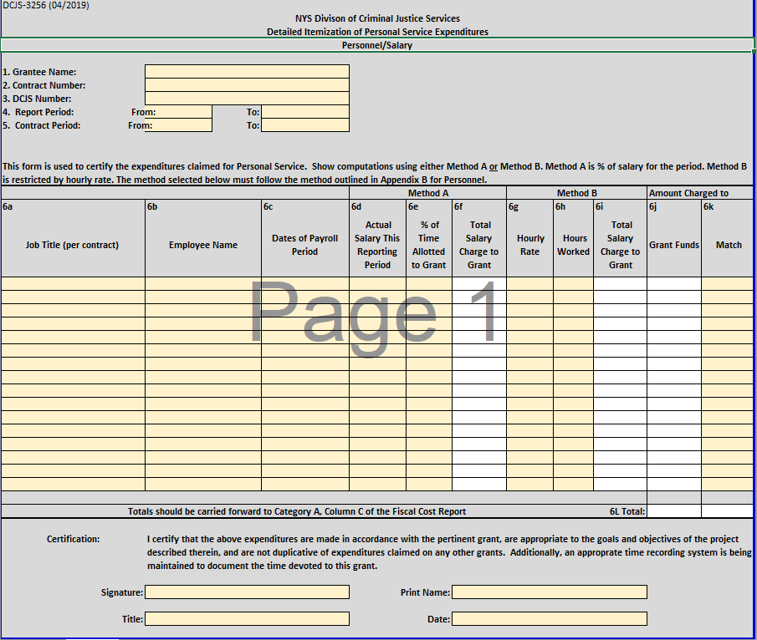
Personnel/Salary Detailed Itemization Form:
Only supply information for Method “A” OR Method “B.”
IF your contract has a “Match” requirement, you will enter the amount in this column.
The job titles on this form need to correspond with the titles in your approved budget.
Dates reflect the range of days worked NOT the dates paid.
The job titles on this form need to correspond with the titles in your budget.
Employees’ names are required.
Enter the amount requesting reimbursement for under the Grant Funds Column.
Please ensure all forms are signed.

Slide 27
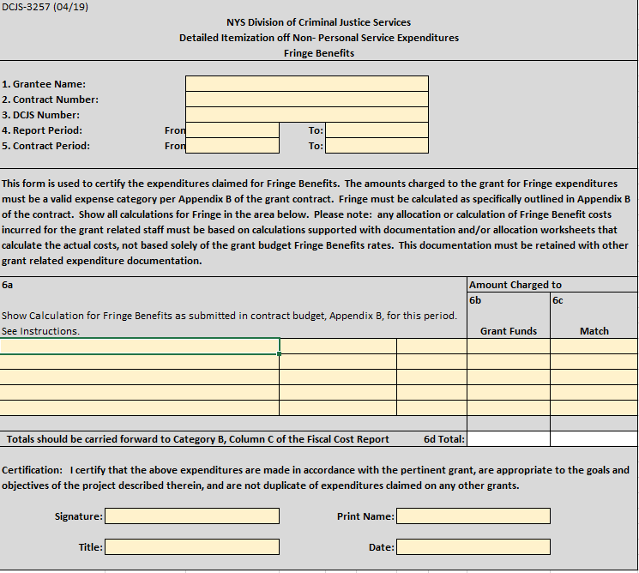
Fringe Detailed Itemization Form:
IF your contract has a “Match” requirement, you will enter the amount in this column.
Enter the details of your Fringe calculation based on your approved budget.
Enter the amount requesting reimbursement for under the Grant Funds Column.
Please ensure all forms are signed.

Slide 28
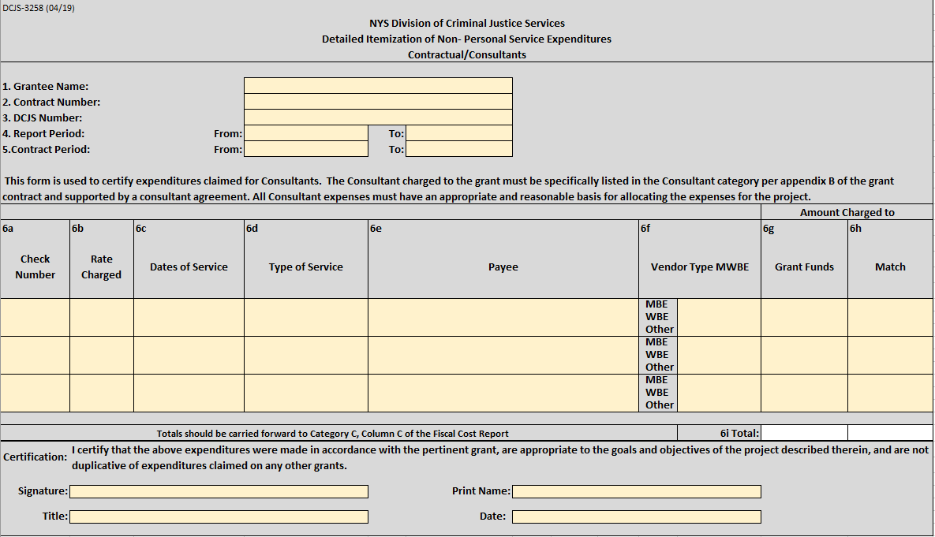
Contractual/Consultants Detailed Itemization Form:
Enter the amount requesting reimbursement for under the Grant Funds Column.
Check number or method of payment must be included.
IF your contract has a “Match” requirement, you will enter the amount in this column.
Complete date or date range is required with month, day & year.
Type of service must agree with approved budget.
Rate charged per itemized line is required. We verify the $650/day limit and seek OPDF’s approval for anything over this rate.
The Payee listed must be the vendor performing the service.
Identify if the vendor used is an approved MBE/WBE.
Please ensure all forms are signed.

Slide 29
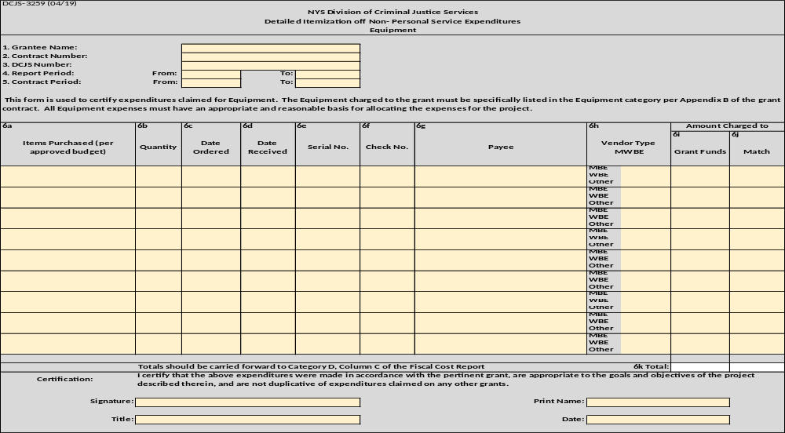
Equipment Detailed Itemization Form:
IF your contract has a “Match” requirement, you will enter the amount in this column.
Items listed must agree with the approved budget.
Dates need to be within the report period and the contract period.
Check number or method of payment must be included.
List the vendor used for each expense.
Identify if the vendor used is an approved MBE/WBE.
Enter the amount requesting reimbursement for under the Grant Funds Column.
Please ensure all forms are signed.

Slide 30
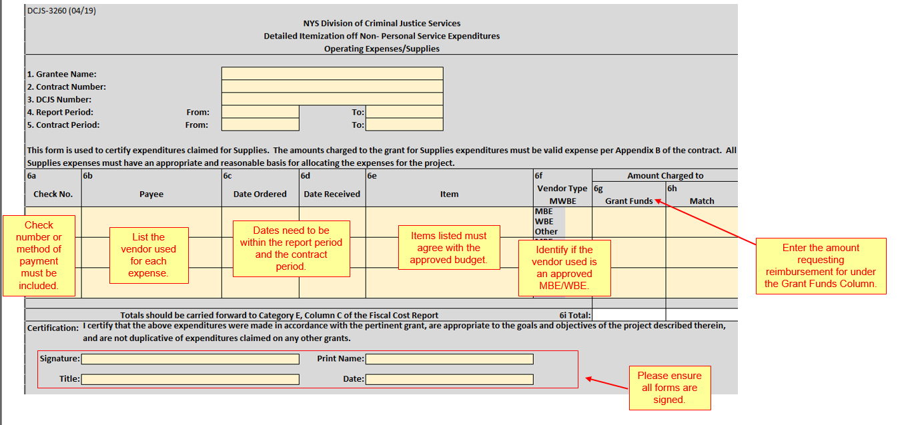
Operating Expenses/Supplies Detailed Itemization Form:
IF your contract has a “Match” requirement, you will enter the amount in this column.

Slide 31
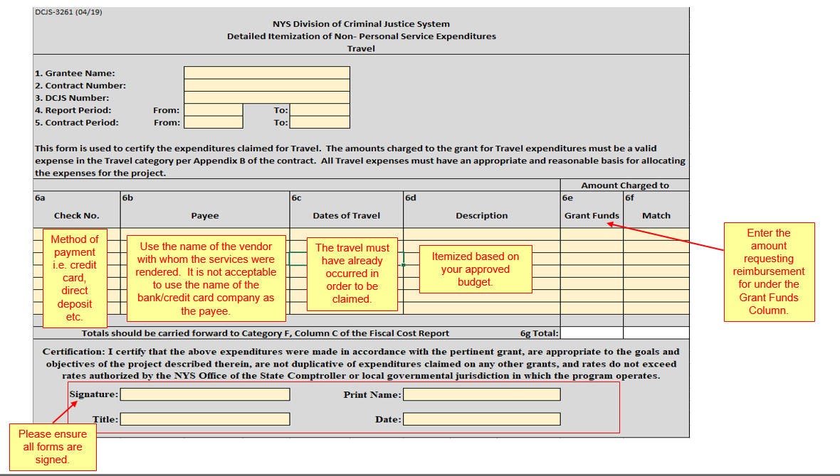
Travel Detailed Itemization Form:
IF your contract has a “Match” requirement, you will enter the amount in this column.

Slide 32
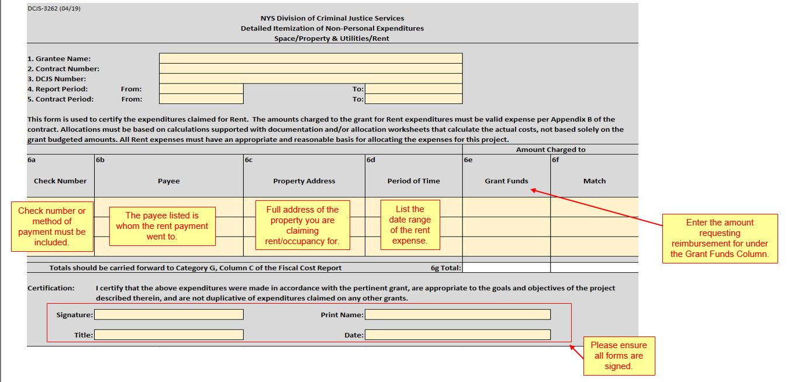
Space/Property & Utilities/Rent Detailed Itemization Form:
IF your contract has a “Match” requirement, you will enter the amount in this column.

Slide 33
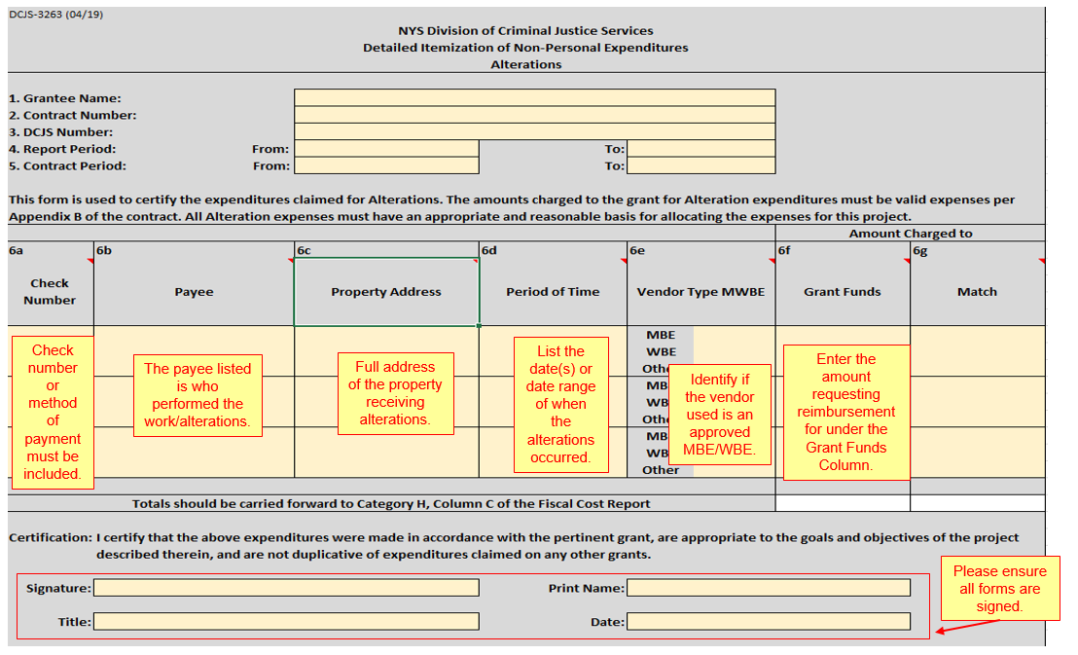
Alterations Detailed Itemization Form:
IF your contract has a “Match” requirement, you will enter the amount in this column.

Slide 34
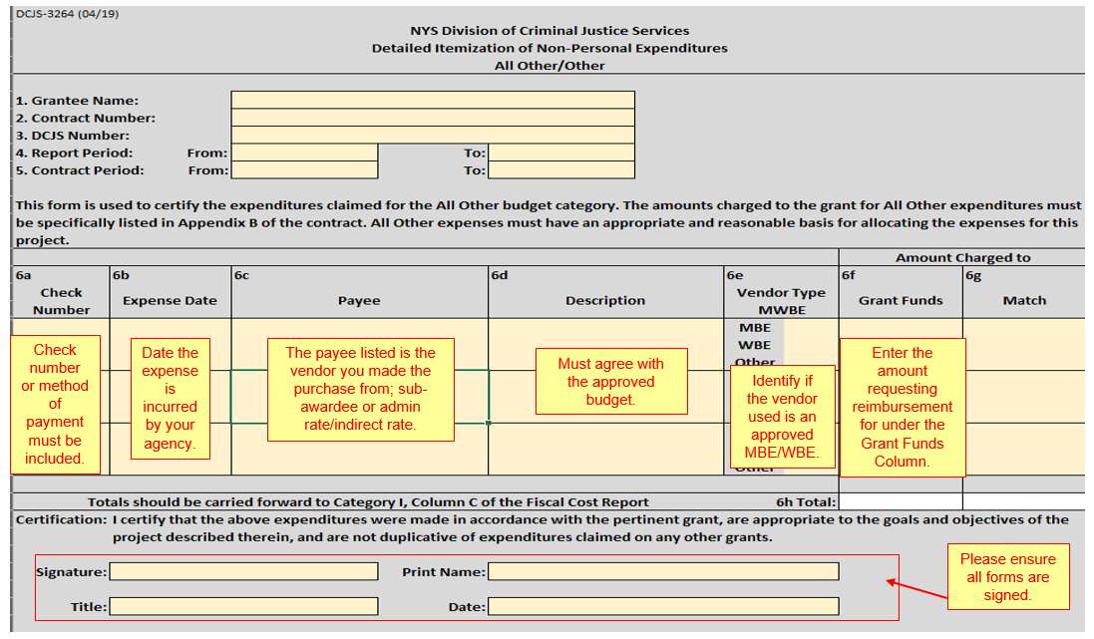
All Other Detailed Itemization Form:
IF your contract has a “Match” requirement, you will enter the amount in this column.

Slide 35
Performance Based Vouchering:
Three types of forms required:
1. Claim For Payment (no changes to this form)
2. Fiscal Cost Report (FCR)
3. Detailed Itemization Form (DIF)
Go to https://www.criminaljustice.ny.gov/ofpa/performance-based-vouchering.html and click on “Guide to Submitting A Performance Based Voucher” to view the forms and guidance on filling these forms out.
These forms are different than expenditure based forms.

Slide 36
Minority and Women-Owned Business Enterprises (MWBE):
Any contract equal to or greater than $25,000 is subject to the MWBE utilization goal. That is, if the contract includes funding in the discretionary categories (ex. Supplies, Equipment, etc.) the grantee may be mandated to spend a minimum of 30 % of the discretionary funds with an MWBE vendor.
MWBE spending goals must be met even if you do not voucher for your full category amount or full contract amount.
To find NYS MWBE approved vendors, go to: https://ny.newnycontracts.com/?TN=ny and click on “search the directory.”
If circumstances do not allow you to meet this goal, you may be eligible to apply for a waiver. To apply for a waiver, contact your Public Safety Grants Representative in OPDF.
If your MWBE goal has not been met by your final voucher then payment on that voucher will be withheld pending resolution.

Slide 37
MWBE, continued:
Forms are found at: https://www.criminaljustice.ny.gov/ofpa/applcntgrntfrms.html
The Local Assistance MWBE Equal Employment Opportunity Staffing Plan (DCJS-3300), completed during the contract process, if the contract exceeds $250,000.
Local Assistance MWBE Workforce Employment Utilization Report (DCJS-3303), completed with the final voucher and only required if the DCJS-3300 was completed during the application process.
Local Assistance MWBE NPS Discretionary Budget Determination Worksheet (DCJS-3309) and a Local Assistance MWBE Subcontractor/Supplier Utilization Proposal Form (DCJS-3301) are completed in conjunction during the contract process to determine the grantee’s MBE and WBE spending goals.
MWBE Subcontractor Utilization Quarterly Report (DCJS-3310), is only required for Performance Based Contracts. For these contracts, the DCJS-3310 is required for each voucher submission.

Slide 38
Advances:
Not-for-Profits (NFPs) may have the opportunity for an advance payment; Municipalities are not eligible for advances. Review Attachment/Appendix-D of your contract to see if an advance is permissible.
Advances are the first payments made against a contract (or budget version in the case of multi-year contracts) and should be requested during the contract process NOT after submitting a voucher.
An NFP may request up to 25% of the contract total and the total amount of any equipment.
After receiving an advance payment every subsequent voucher will be reduced by 50%, until fully paid, as part of the advance recoupment process.
If an advance is not fully recouped by your final voucher, all payments to the grantee will be withheld on ALL open contracts pending resolution.

Slide 39
General Vouchering Guidance:
Please do not submit a voucher until you have been notified that your contract is executed by an automated e-mail or your Public Safety Grants Representative.
Voucher submission is due 30 days after the end of the quarter.
Please ensure that the correct contact information for your organization is reflected in the Grants Management System (GMS) or Grants Gateway (GG) and on the FCR (Fiscal Cost Report).
In order to be reimbursed for a cost it must be ordered, received and paid for.
  NOTE: Ordering and receiving must have occurred during the contract period. Payment can take place after the contract end date; however, payment must occur prior to the voucher being submitted.
Your organization must have an up to date address and banking information must be current in the State Financial System (SFS) to ensure payment is not delayed.

Slide 40
Electronic Funds Transfer (EFT):
Grantees are contractually required to sign up to receive payments electronically.
  Electronic payments are received sooner than a paper check. Please be sure you have Electronic Funds Transfer checked so the payment will automatically be deposited and not sent as a paper check.
To sign up for ePayments:
1. Log into the Vendor Self –Service Portal: https://esupplier.sfs.ny.gov/psp/fscm/SUPPLIER/
  If you don’t have a Self-Service Portal Account, sign up at: https://osc.state.ny.us/vendors/vendorselfservicesystem.htm
2. Select “Enroll in ePayments” (Direct Deposit) Link
3. Follow the prompts to complete your enrollment
For Assistance, contact ePayments@osc.state.ny.us

Slide 41
Finance Contact Information:
You can contact DCJS Finance at:
DCJSGrantsUnitVoucherInquiry@dcjs.ny.gov
Please direct any voucher related questions to DCJS Finance, not your Public Safety Grants Representative.
All vouchers should be submitted via mail to:
    NYS Division of Criminal Justice Services – Finance/Grants Unit
    Alfred E. Smith State Office Building – 10th Floor
    80 South Swan Street
    Albany, NY 12210

Slide 42
  QUESTIONS ?

Slide 43
Audit Basics
John Clements– DCJS Office of Audit Services
Deputy Director

Slide 44
Audit Objectives
Identify instances of fraud, waste & abuse
Verify that the grantee has complied with the fiscal & programmatic requirements of the grant contract
Determine if reimbursed costs are adequately supported and related to the grant program

Slide 45
Audit Process
Review reimbursed costs, GMS, and do online research
Call grantee representative
Send out confirmation email
Meet with DCJS stakeholders
Opening conference
Field work
Post field work
Reporting process

Slide 46
Audit Documentation
Time and effort tracking
Evidence of procurement requirements being met
Written agreements for consultants and sub-grantees
Evidence of work performed
Invoices and proof of payment for reimbursed expenses
Evidence of allocation methodology for shared costs
Case files for performance based contracts

Slide 47
Additional Audit Steps
Meet with program staff
Tour leased space
View equipment and verify it is in use for grant related purposes
Meet with consultant or sub-grantee representatives
Understand program benefit of grant funded travel
Meet with program participants

Slide 48
Common Audit Findings
Lack of time and effort tracking
Insufficient evidence of work performed on grant program
Inadequate monitoring of consultants and sub-grantees
Reimbursement for costs incurred outside of contract period
Reimbursement requests for budgeted amounts instead of actual costs
Lack of allocation methodology for shared costs
Procurement requirements not followed
Poor/missing case file documentation for performance based contracts

Slide 49
  QUESTIONS ?

